Slide 1
Wise Compliance Case Study
NorthAm Compliance Data Analyst
Stone Leiker | March 2025

Slide 2
Case Study Overview
Goal: Address two regulatory requests (R1 & R2) using customer transaction data and provide clean, auditable outputs.
Regulatory Requests:
R1: ○ Total cross-currency volume in GBP under UK Entity between 01/04/2022 and 01/08/2023
R2: ○ Total cross-currency volume in GBP under US Entity between 01/04/2022 and 01/08/2023 ○ Total same-currency volume in GBP under US Entity between 01/04/2022 and 01/08/2023

Slide 3
My Approach
Step 1: Excel Preparation
Converted the PDF to Excel manually
Used formulas to split combined text into clean columns: customer_id, customer_type, current_address_county, and customer_since_date
Save as .csv for clean import
Step 2: SQL cleaning & view creation
Imported .csv into SQL server
Created view vw_CleanedWiseStudyCase
Handled all NULLS and blank fields using Coalesce and NULLIF
Step 3: Power BI Visualization
Built a full dashboard with slicers, chart trends, and category, breakdowns
Verified totals and joined dates across customer types.

Slide 4
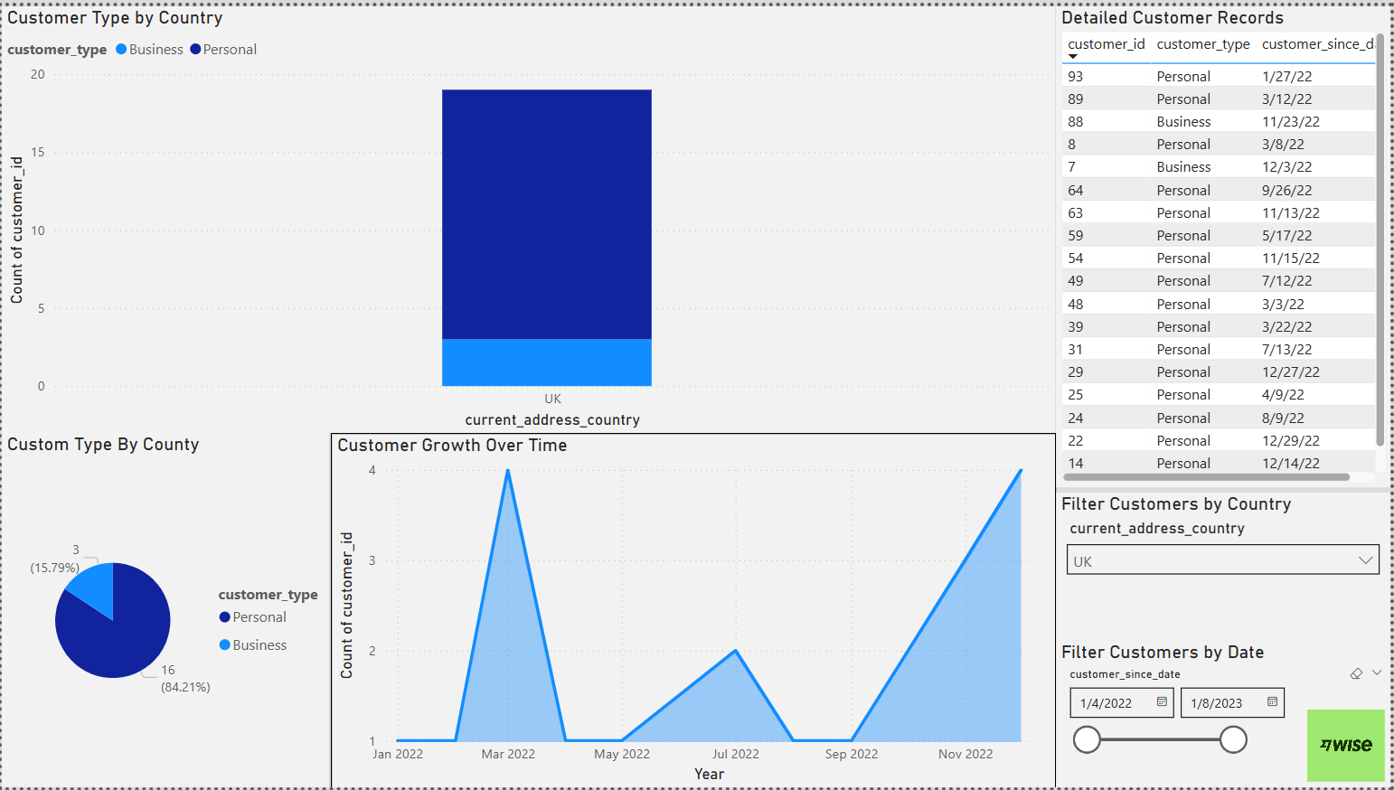
R1 – UK Entity Results
Regulatory Request R1:
Goal: Total cross-currency volume under the UK Entity, where the customer is based in the UK and the route includes GBP.
Approach:
Filtered by:
Current_address_country = UK
Customer_since_date between 01/04/2022 and 01/08/2023
Used Power BI filters to simulate UK-based customer activity
Recommendation for Accurate Currency Reporting:
The current dataset lacks currency direction fields to reliably distinguish between cross-currency and same-currency transactions.
To improve accuracy, I recommend requesting the data team to include:
Currency_sent
Currency_received
This would allow accurate classification of:
Cross-currency: USD > GBP
Same-currency: GBP > GBP

Slide 5
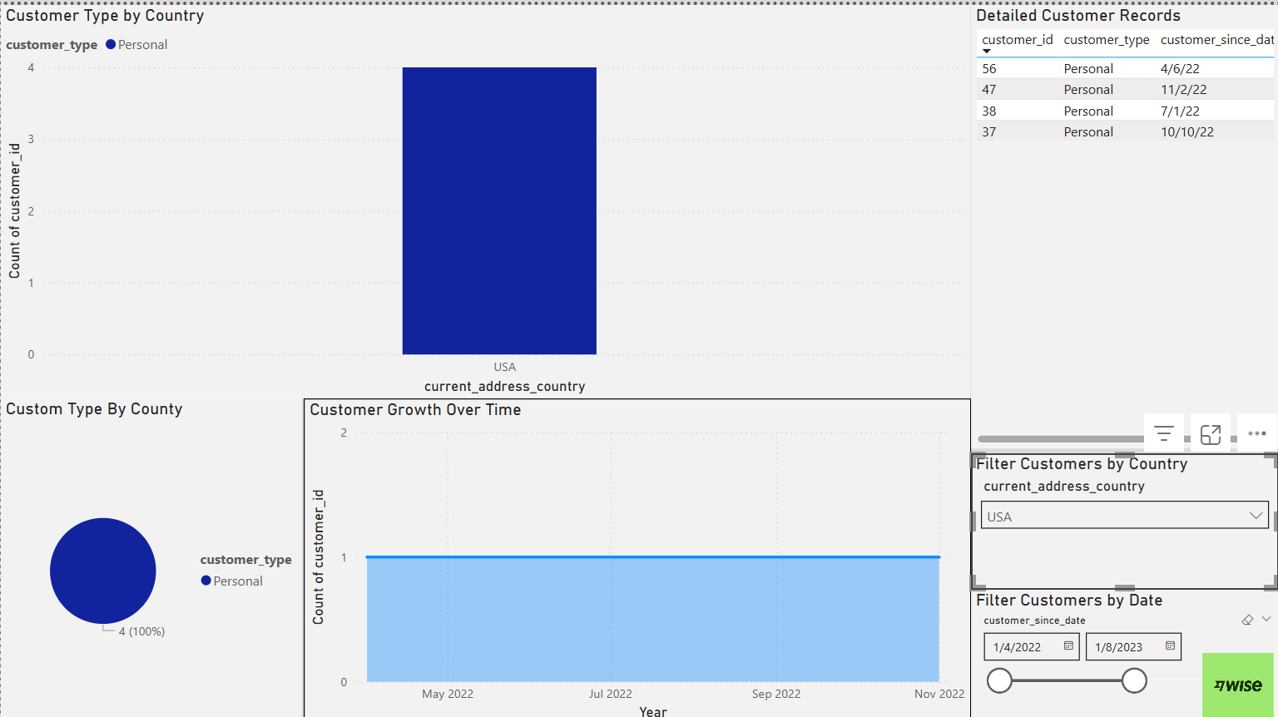
R2 – US Entity Results
Regulatory Request R2:
Goal:Total cross-currency volume + same-currency volume under the US Entity, Where customer is based in USA and route includes GBP.
Approach:
Filtered by:
Current_address_country = USA
Customer_since_date between 01/04/2022 and 01/08/2023
Simulated volume breakdown using available customer data
Currency-Level Classification:
Follows the same recommendation outlined in R1: Include currency_sent and currency_received fields to ensure proper classification between cross-currency and same-currency transfers.

Slide 6
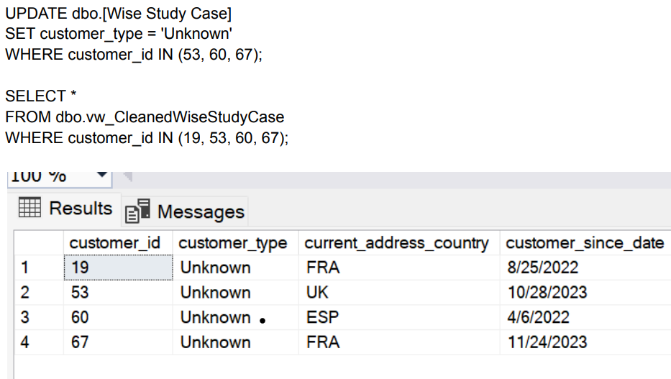
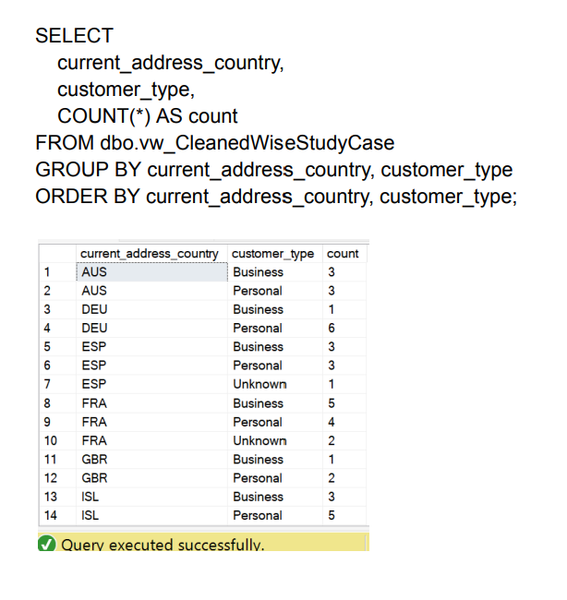
SQL Cleaning Logic
Key View: vw_CleanedWiseStudyCase
Key Objective:
Create a clean, complete, and audit-ready customer dataset to support reporting, filtering, and verify accuracy in downstream analysis.
Cleaning Steps Taken:
Created SQL view: vw_CleanedWiseStudyCase
Replaced all blank or NULL values using:
COALESCE(NULLIF(...), 'Unknown') for:
Customer_type
Manually updated specific NULL values for:
customer_id = 19, 53, 60, 67
Created grouped summaries to verify:
All customer types are filled
All current address countries are accounted for
All 100 rows include valid customer_since_date

Slide 7
Data Quality & Validation
Short-Term Actions:
Identified and fixed 4 rows with missing customer_type
Trimmed and cleaned all values for readability and consistency
Validated that all 100 rows had complete and usable data
Long-Term Proposal:
Build automated pre-ingestion validation scripts
Flag unexpected or NULL values, including fields such as customer_type
Standardize logic for:
Entity classification (It would be helpful to have entity_id and account_open_country)
Transaction routing fields such as sender_country, receiver_country
Additional logic to support enhanced compliance (more details in Slide 10)
Prepare data to be regulator-ready at the source for faster submission and easier auditing

Slide 8
Regulatory Reporting Process (Proposal)
Recommended Reporting Pipeline:
Input from standard format (CSV, API)
SQL logic applied in staging layer
Power BI used for validation & internal review
Final output prepared for regulatory submission
Stakeholder Flow:
Compliance defines rules & flags
Data team prepares & validates
Reporting team submits audited output

Slide 9
Tools Used
Excel: For early-stage data structuring and cleanup
SQL Server: To clean and transform raw data
Power BI: To visualize, filter, and validate results
Text/Code Output: PDF, SQL file, dashboard slides for delivery
Deliverables Provided: Clean SQL Script CSV Dataset PBIX Dashboard This Slide Deck (Final Presentation)

Slide 10
Final Summary & Recommendations
Addressed both R1 and R2 requirements
Built a repeatable and scalable data pipeline
Cleaned and validated full dataset (100 rows)
Delivered all files, visuals, and audit-ready SQL
Ready to answer questions or expand this into an automated workflow for real-time regulatory reporting.
Recommended Enhancements:
Adding currency_sent / currency_received fields
Logging metadata (file version, data source, row count)
Including entity_id for legal classification
Validating country codes and routing fields during ingestion
Adding account_open_country to support consistent entity mapping
Capturing IP_address for location validation and fraud detection
Tracking failed login_attempts ( COUNT(*) > 3) to prevent unauthorized access
Validating transaction amounts to ensure they fall within expected ranges (1 to 10,000 GBP)

